Slide 1
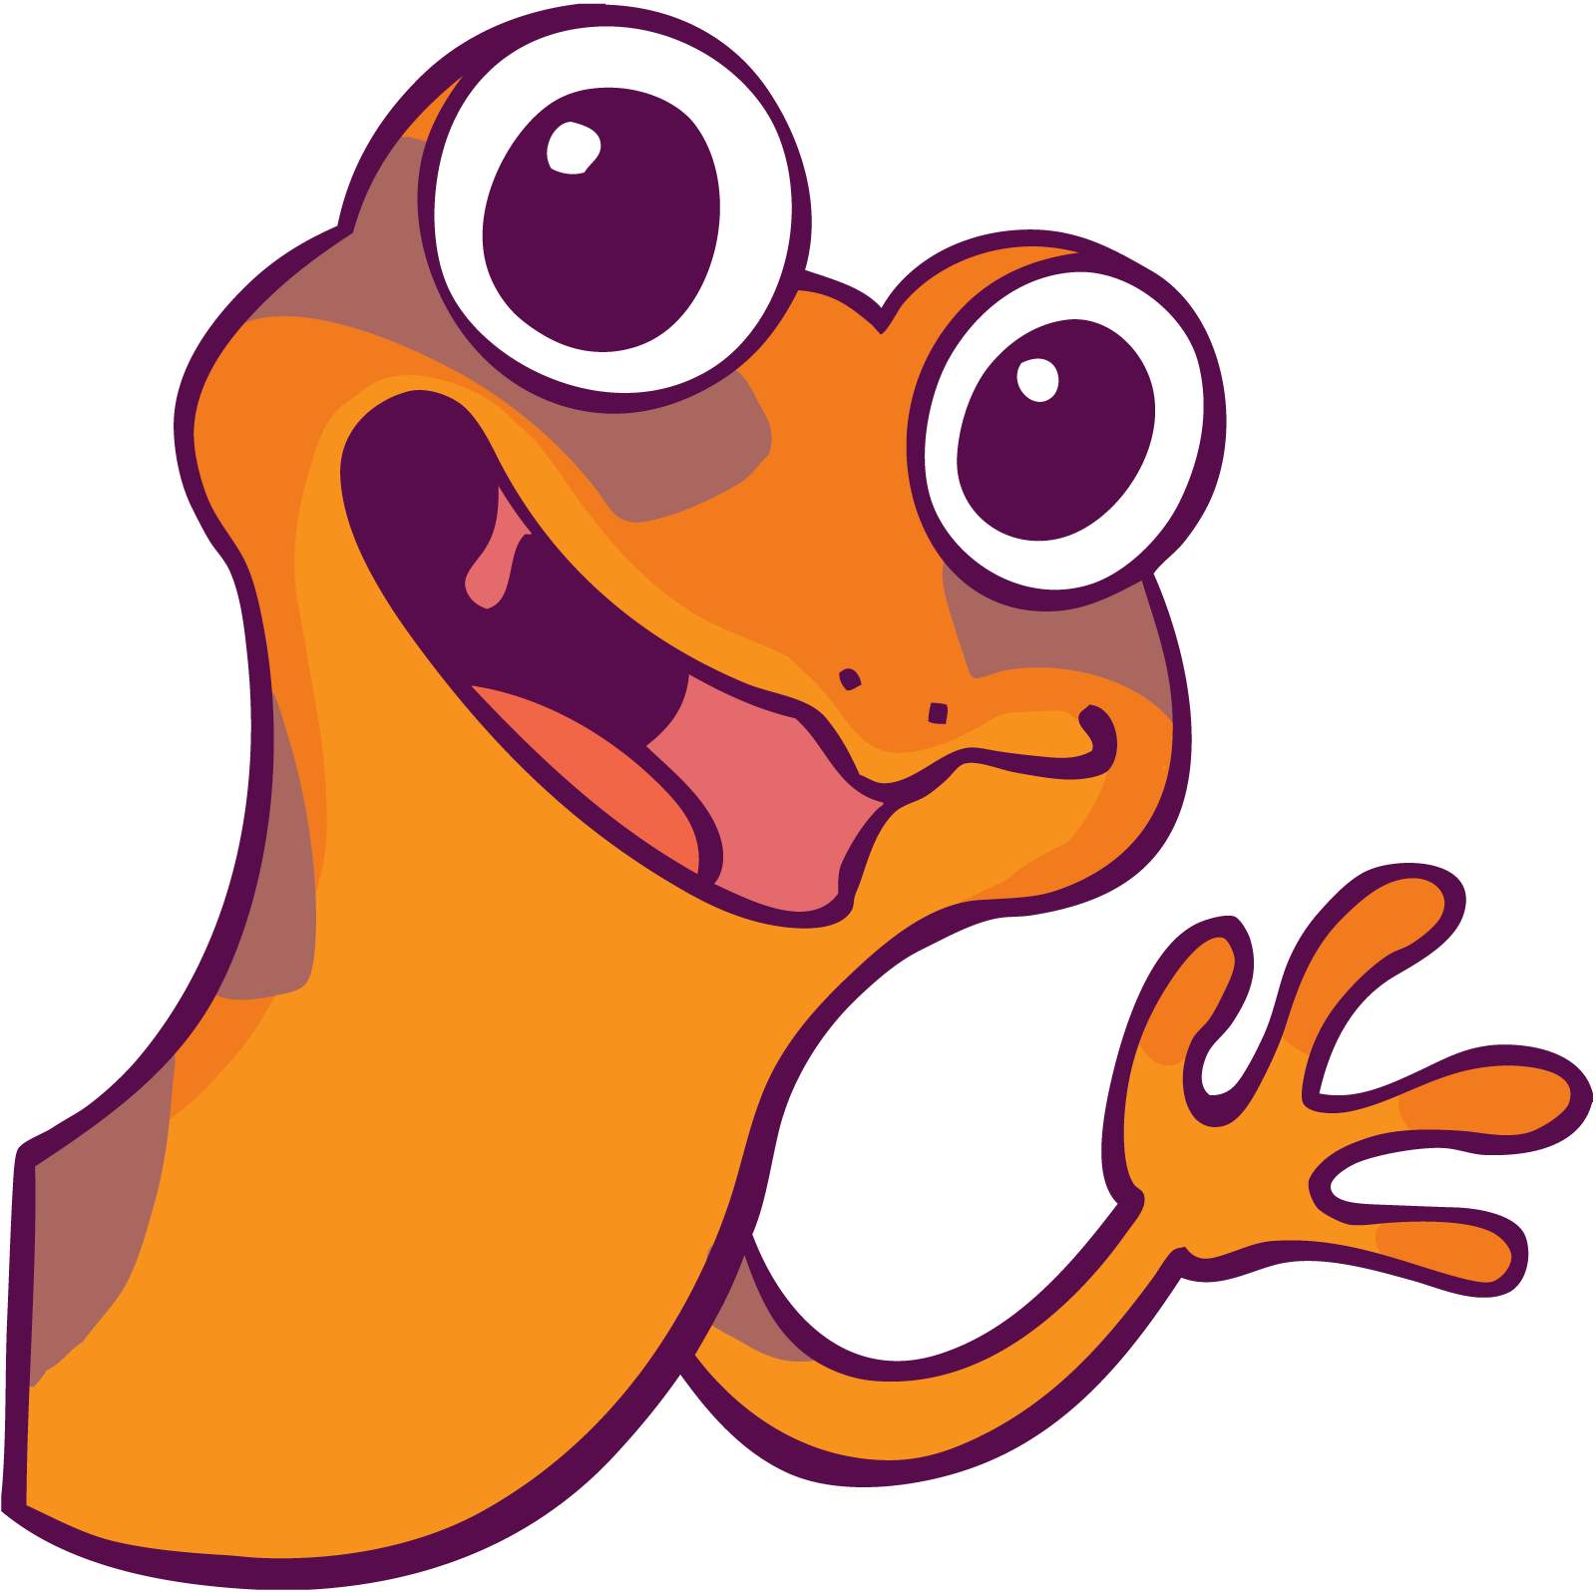
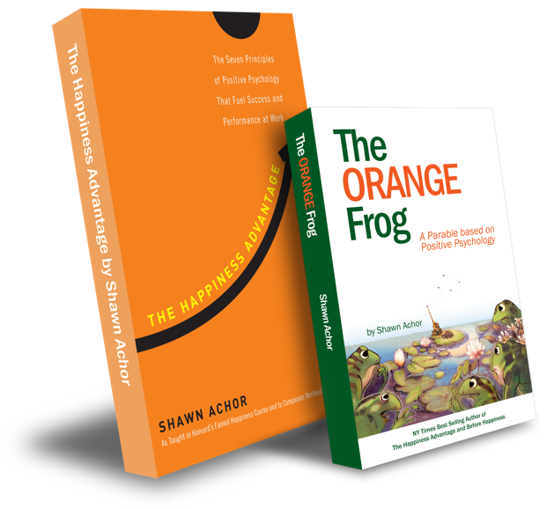
The Orange Frog
The Fun 15

Slide 2
Week Four

Slide 3
The Fun Fifteen
Learning Objective:
I can reflect on my 21-day challenge and determine the importance of the Fun Fifteen
I will discuss the importance of being able to look back and decide if the tactic had an impact on my life or not.
Notes:
Standard:
Essential Concept and/or Skill: Communicate and work productively with others emphasizing collaboration and cultural awareness to produce quality work.
Interact positively as a team member.
Cooperate with others in a group setting.
Generate ideas with group members.
Are active listeners.
Read and understand information in a variety of forms.
Express ideas.
Skill:
Active listening, express ideas

Slide 4
Skills
Self Management
Responsible decision making

Slide 5
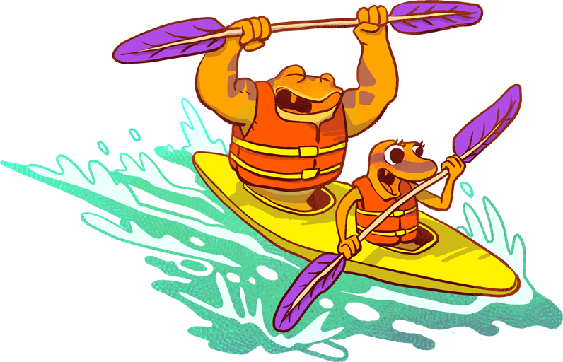
“Does anyone remember what it means to reflect?”
“What do you remember about other reflection activities we have done”

Slide 6
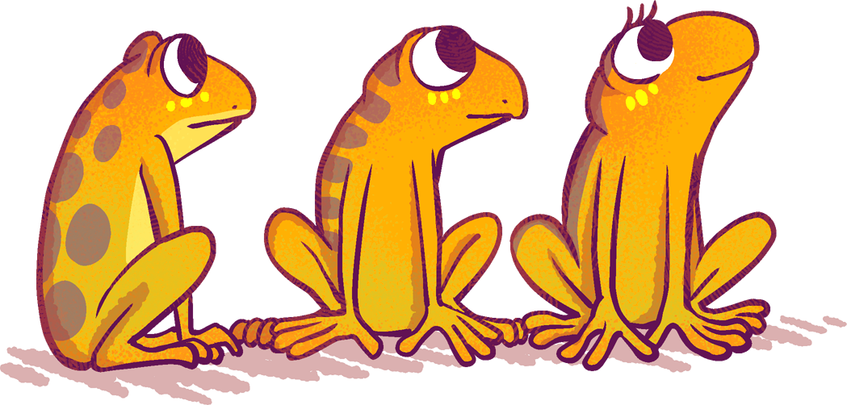
Thoughts
Remember, when we reflect back, it can be just like looking in a mirror. We must think about what we have done, what we have said, and how it has changed our day. Reflecting on this tactic might be harder since we don’t have a journal to look back on.

Slide 7
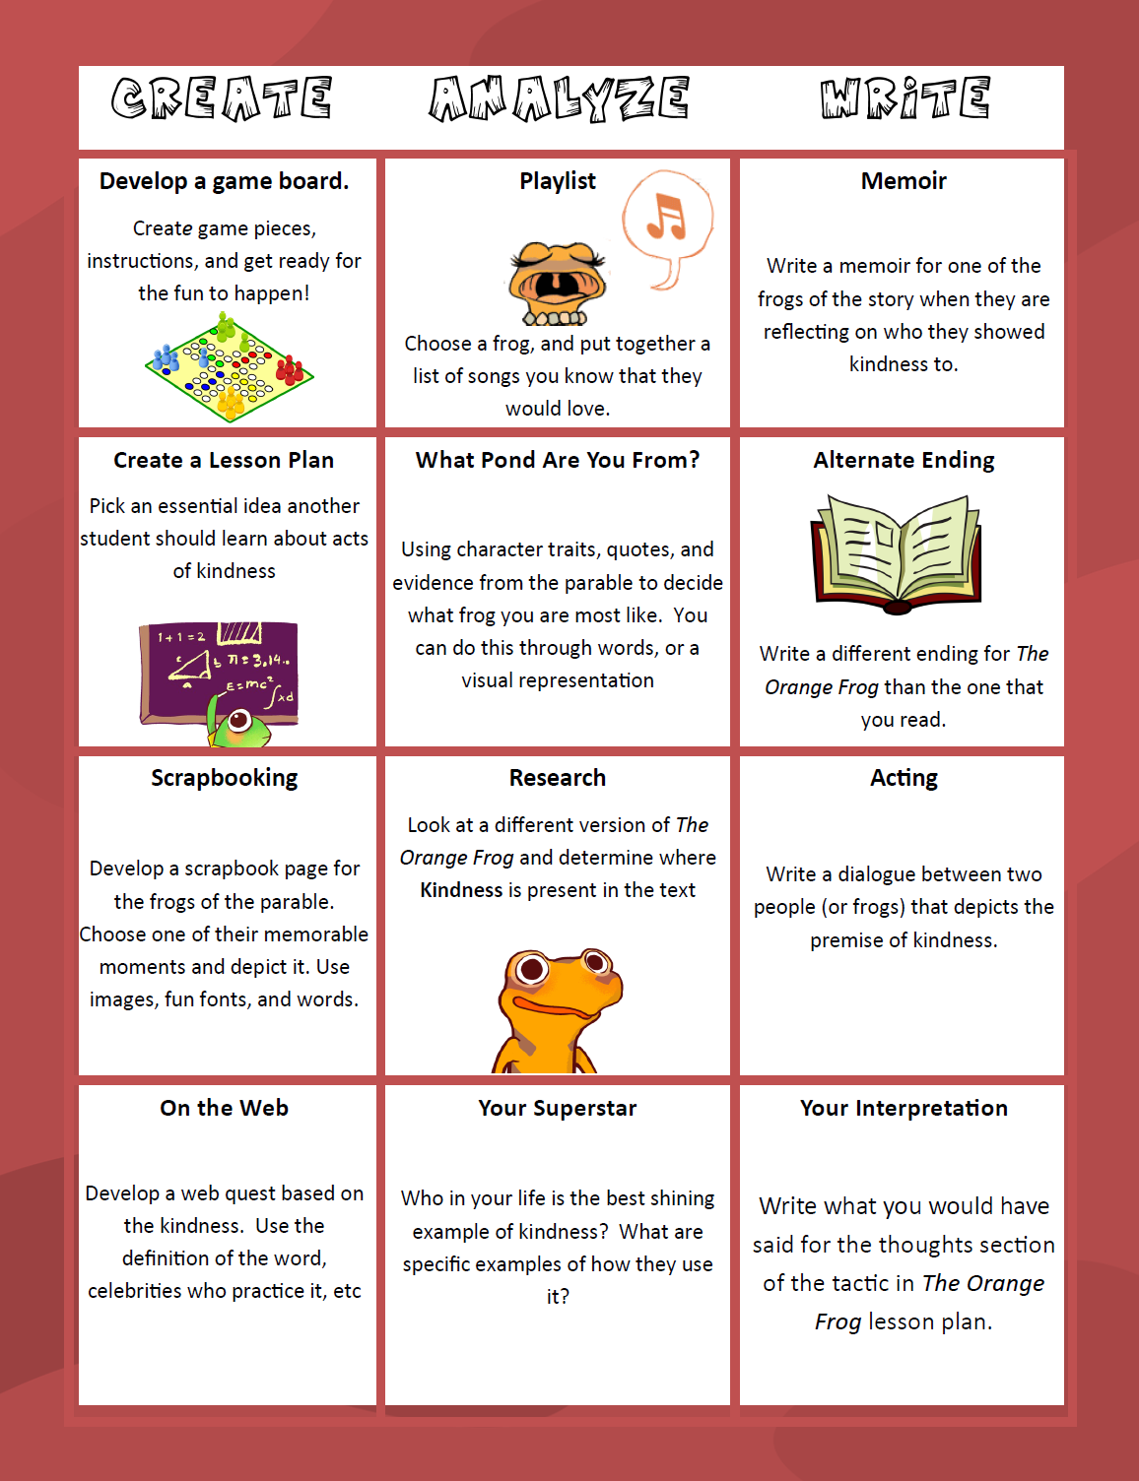
Activity
Today, we are going to look back and reflect on the impact of the tactic. Not only are we going to do that, but we are going to develop a tool that younger grades could use to show their understanding of “The Fun 15”

